Slide 1


Capitalizing Social Buzz Data

Slide 2


Today's agenda
Project recap
Problem
The Analytics team
Process
Insights
Summary

Slide 3

We are running a 3 month initial project with Social Buzz, in order to prove to them that we are the best firm to work with. They are expecting the following:
An audit of their big data practice
Recommendations for a successful IPO
An analysis of their content categories that highlights the top 5 categories with the largest aggregate popularity
Project Recap

Slide 4


Problem
Social Buzz generates over 100,000 posts per day, and 36,500,000 pieces of content per year.
How can they utilize this data to expand and improve upon business processes with this data?
Let’s take a look at the top 5 scoring categories, and see what other insights we can gain from the data.

Slide 5



Andrew Fleming
Chief Technical Architect
The Analytics team
Marcus Rompton
Senior Principle
Keith Deuser
Data Analyst

Slide 6
Process
1
Collect Data
2
Clean Data
3
Merge Tables
4
Analyze Data
5
Visualize Insights

Slide 7

Insights
16
1897
January
Unique Categories
Reactions to “animals”
Highest Number of Posts

Slide 8
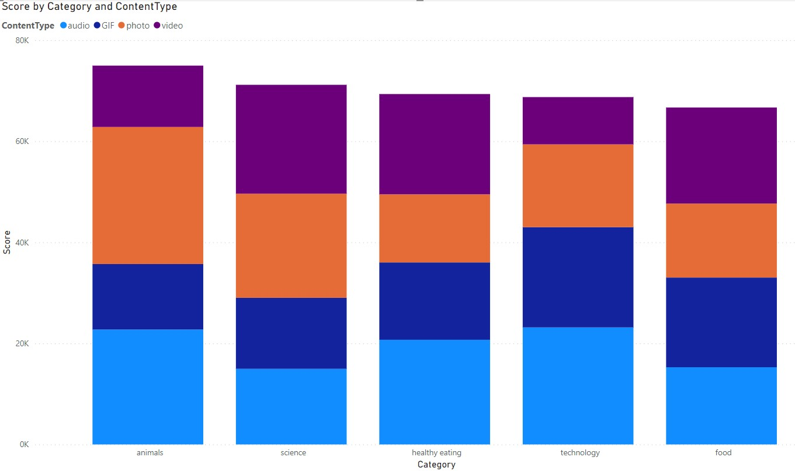

Slide 9
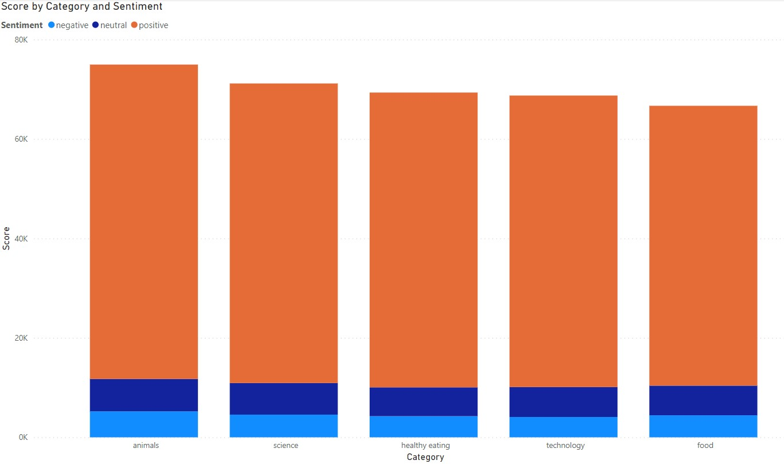

Slide 10
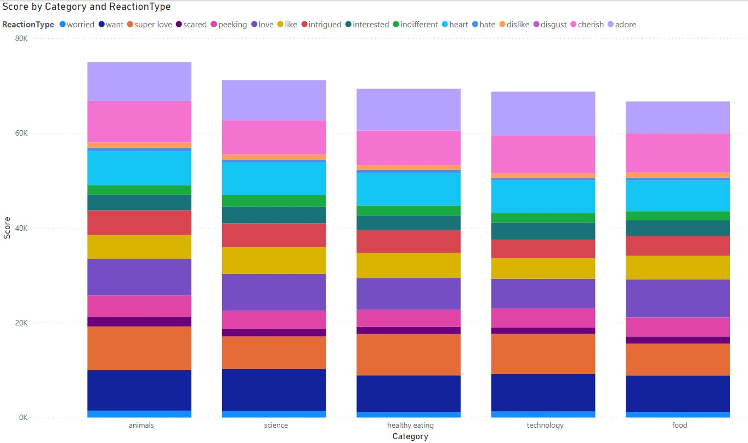

Slide 11

ANALYSIS
Based on the analysis, “animals” and “science” are the most popular categories, with the largest proportion of content type being “photo” and “video” for both categories.
INSIGHTS
“healthy eating” and “food” are also in the top 5 categories, indicating the majority of the user base is interested in healthy foods. This knowledge could be used to help boost engagement from other brands focused on healthy eating.
Summary

Slide 12

Thank you!
ANY QUESTIONS?

